Slide 1
Lean CANVAS

Slide 2
about
The Lean Canvas is an adaptation of Business Model Canvas and it is especially designed for entrepreneurs. The canvas focuses on problems, solutions, key metrics and competitive advantages.
When the Business Model Canvas was introduced, all examples shown were business models from existing and mature businesses. Therefore Ash Maurya redesigned it and created the Lean Canvas that is more actionable and entrepreneur-focused.
Lean Canvas includes aspects for startups to deal with uncertainty and risk.

Slide 3
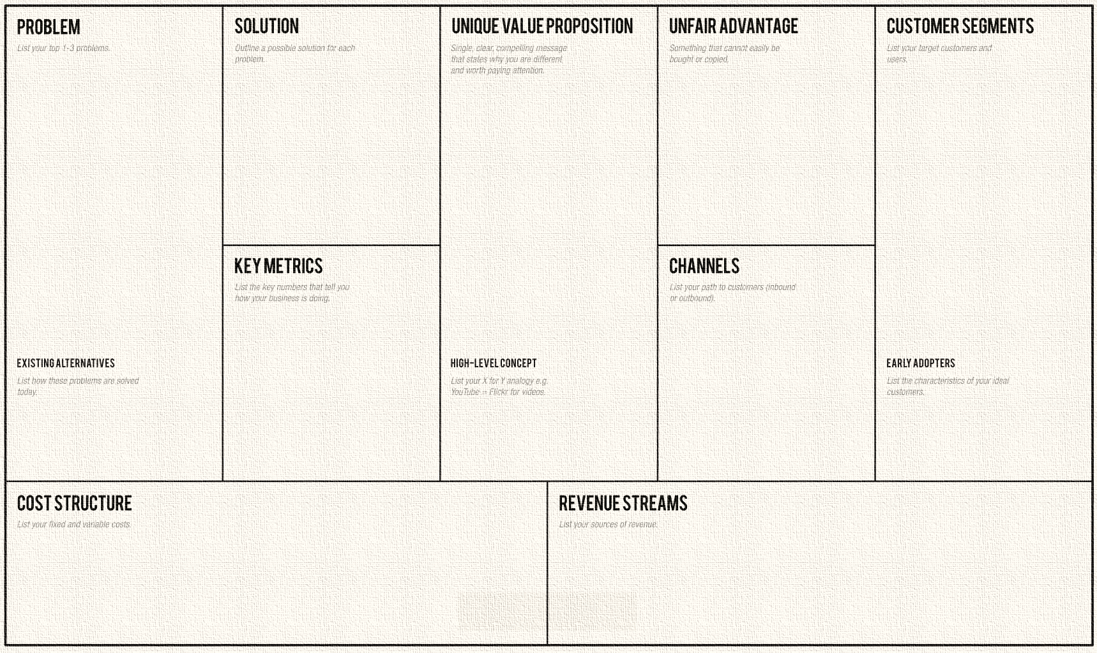

Slide 4
comparison
Strengths
Weakness
Compared to writing a business plan which can take several weeks or months, you can outline multiple possible business models on a canvas in one afternoon.
A single page business model is much easier to share with others which means it will be read by more people and also more frequently updated.
Effective: Whether you're pitching investors or giving an update to your team or board, our built-in presenter tools allow you to effectively document and communicate your progress.
Partners and value exchange between different actors is not visible
Defining the unfair advantage can set barriers in a to early stage of the development of the idea
No team or cultural aspects (only within resources)
Missing building blocks for special usage, such as sustainable business models

Slide 5
Electronic Marketing.
If you’re starting an ecommerce business, odds are you’ll fall into at least one of these four general categories.
Each has its benefits and challenges, and many companies operate in several of these categories simultaneously.
Knowing what bucket your big idea fits in will help you think creatively about how what your opportunities and threats might be.

Slide 6
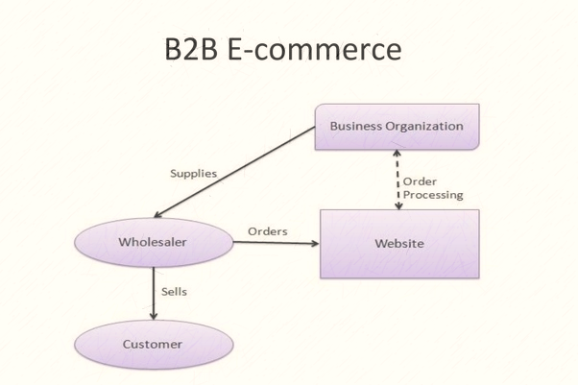
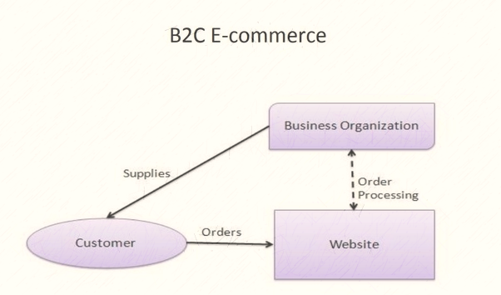
B2B (Business to Business) e-commerce is simply defined as ecommerce between companies.
About 80% of e-commerce is of this type.
Example: – Intel selling microprocessor to Dell
Business-to-consumer e-commerce, or commerce between companies and consumers, involves customers gathering information; purchasing physical goods or receiving products over an electronic network.
Example: – Dell selling me a laptop

Slide 7
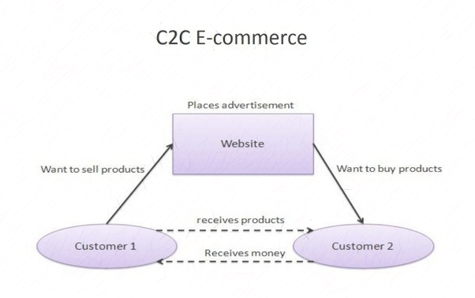
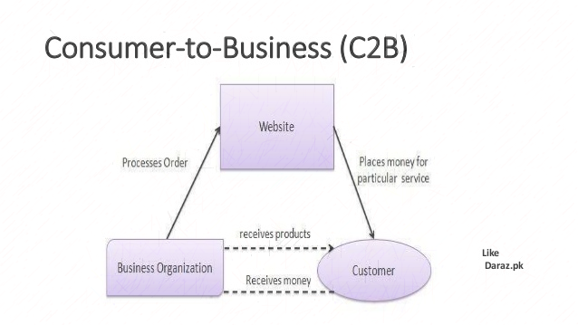
Consumer-to-consumer e-commerce or C2C is simply commerce between private individuals or consumers.
Example: – Mary buying an iPod from Tom on eBay – Me selling a car to my neighbor
Consumer-to-Business in which consumers (individuals) create value and businesses consume that value
Example: a YouTuber sells ad spaces to advertisers (Businesses)

Slide 8
Value Proposition Canvas
The Value Proposition Canvas is a tool which can help ensure that a product or service is positioned around what the customer values and needs.
The Value Proposition Canvas was initially developed by Dr Alexander Osterwalder as a framework to ensure that there is a fit between the product and market. It is a detailed look at the relationship between two parts of the Osterwalder’s broader Business Model Canvas; customer segments and value propositions.
It can be used when there is need to refine an existing product or service offering or where a new offering is being developed from scratch.

Slide 9
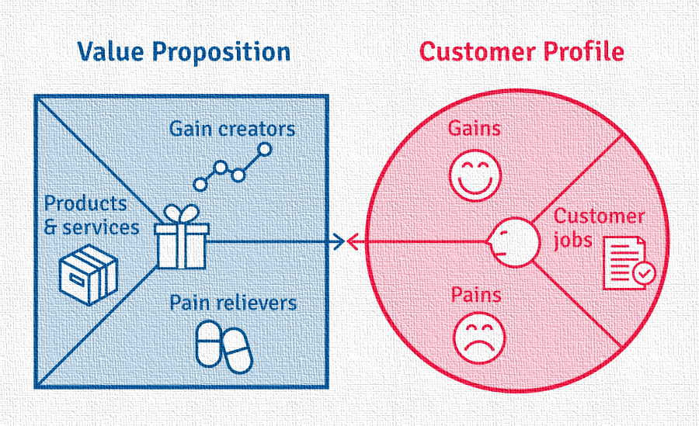
Customer Profile
Gains – the benefits which the customer expects and needs, what would delight customers and the things which may increase likelihood of adopting a value proposition.
Pains – the negative experiences, emotions and risks that the customer experiences in the process of getting the job done.
Customer jobs – the functional, social and emotional tasks customers are trying to perform, problems they are trying to solve and needs they wish to satisfy.
A customer profile should be created for each customer segment, as each segment has distinct gains, pains and jobs.
Value Map
Gain creators – how the product or service creates customer gains and how it offers added value to the customer.
Pain relievers – a description of exactly how the product or service alleviates customer pains.
Products and services – the products and services which create gain and relieve pain, and which underpin the creation of value for the customer.

Slide 10
Thanks for your attention ☺

